Slide 1
Luggage Point Advanced WTP Water Reuse

Slide 2
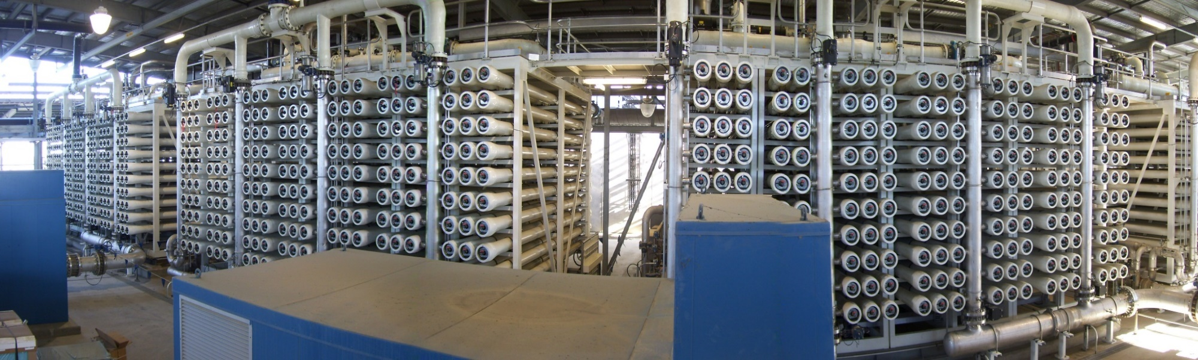
Western Corridor Recycled Water Project -
Luggage Point Advanced WTP
Owner: SeqWater (Queensland Government)
Client: Luggage Point Alliance (JV: CH2M Hill, Australia & Laing O’Rourke, Connell Wagner and Hatch)
Location: Brisbane, Australia
Capacity: 6.2 MGD x 4 trains producing a total 18.5 MGD
Start-up: 2010 Application: Indirect potable water reuse
“This project was a key component to Australia’s larger recycled water scheme.”
www.SafBonWater.com

Slide 3
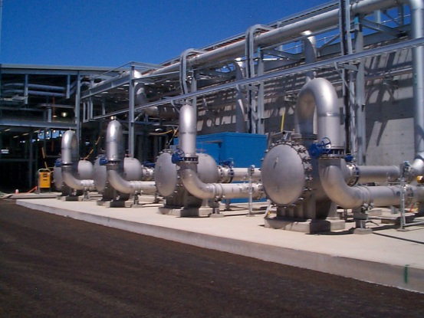
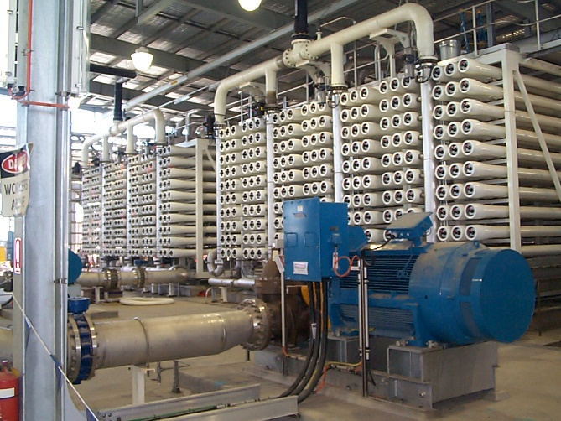
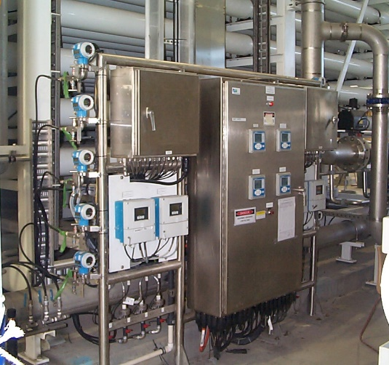
SafBon Water Technology was contracted to provide the design, manufacturing and supply of the 18.5 MGD brackish water RO system treating filtered secondary wastewater. The SWT scope of supply included four, three-stage RO systems in a double stack per train configuration. Also supplied were four high pressure feed pumps, UF feed water booster pumps, CIP system, Toray membranes, instrumentation and PLC control system. Field services included installation supervision, system testing, commissioning and start-up as well as training of the owner’s personnel.
Feed water TDS: 500-4000
Permeate TDS: 50
Permeate flow: 13,000 GPM
RO Recovery: 85%, 1470 Membranes
Others: 120/60/30 Array - 3 Stage w/ ERT
Operational Data:

