Slide 1
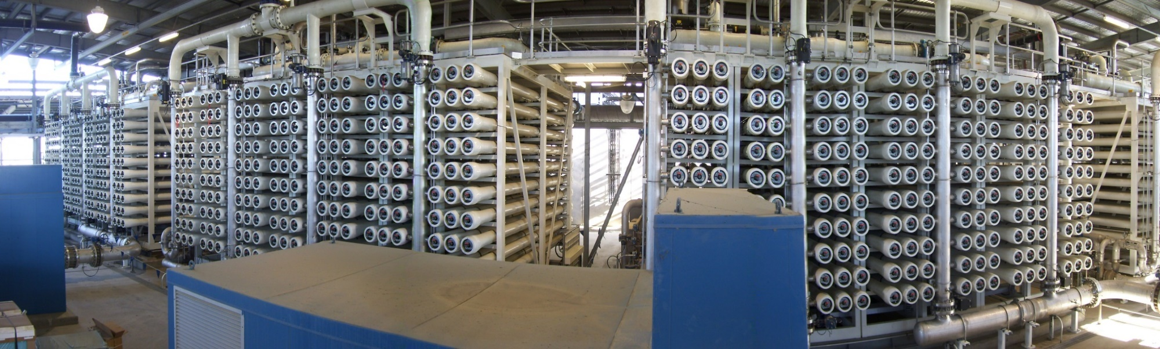
Western Corridor Recycled Water Project -
Luggage Point Advanced WTP
Owner: SeqWater (Queensland Government)
Client: Luggage Point Alliance (JV: CH2M Hill, Australia & Laing O’Rourke, Connell Wagner and Hatch)
Location: Brisbane, Australia
Capacity: 6.2 MGD x 4 trains producing a total 18.5 MGD
Start-up: 2010 Application: Water reuse; indirect potable
“This project was a key component to Australia’s larger recycled water scheme.”
www.SafBonWater.com

Slide 2
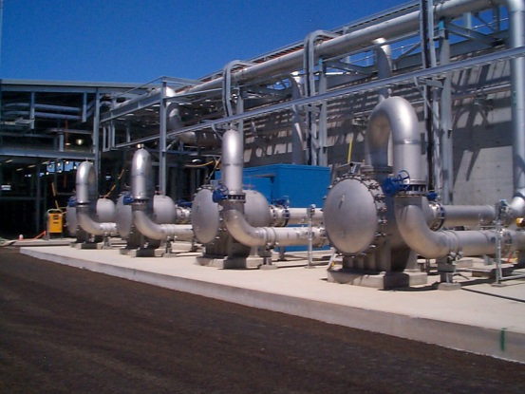
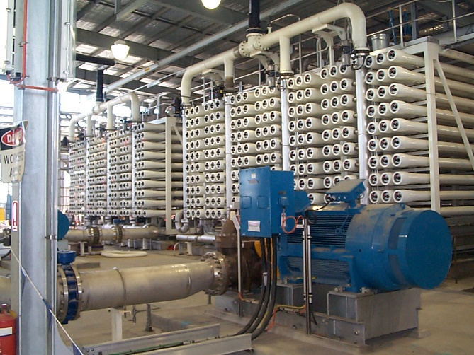
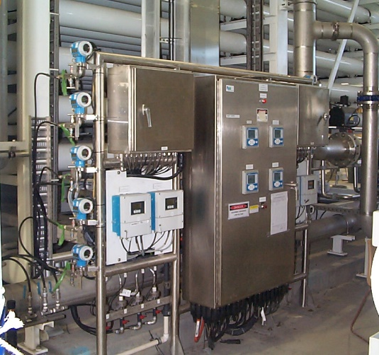
SafBon Water Technology was contracted to provide the design, manufacturing and supply of the 18.5 MGD brackish water RO system treating filtered secondary wastewater. The SWT scope of supply included four, three-stage RO systems in a double stack per train configuration. Also supplied were four high pressure feed pumps, UF feed water booster pumps, CIP system, Toray membranes, instrumentation and PLC control system. Field services included installation supervision, system testing, commissioning and start-up as well as training of the owner’s personnel.
  Feed water TDS: 500-4000
  Permeate TDS: 50
  Permeate flow: 13,000 GPM
  RO Recovery: 85%, 1470 Membranes
  Others: 120/60/30 Array - 3 Stage w/ ERT
Operational Data:

Slide 3
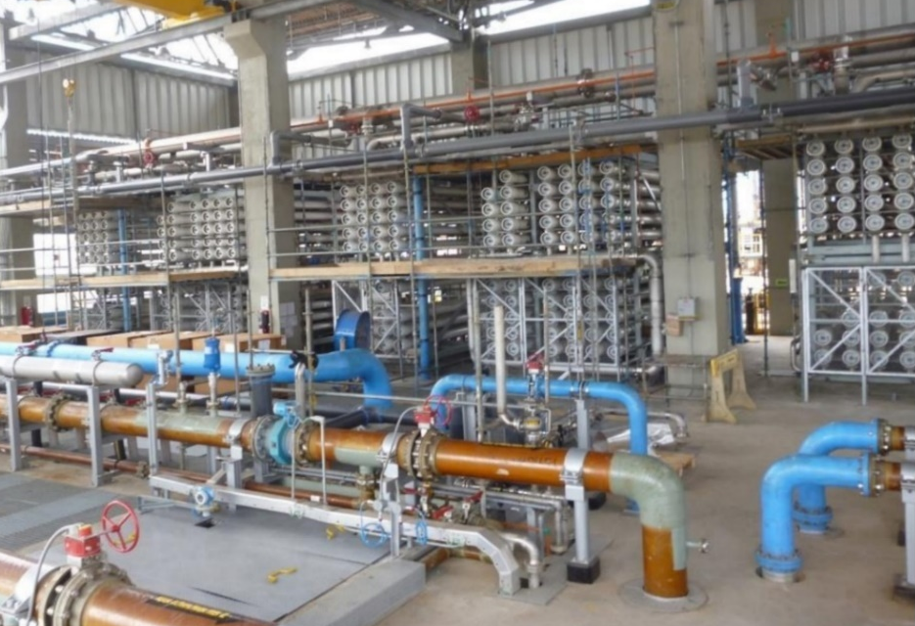
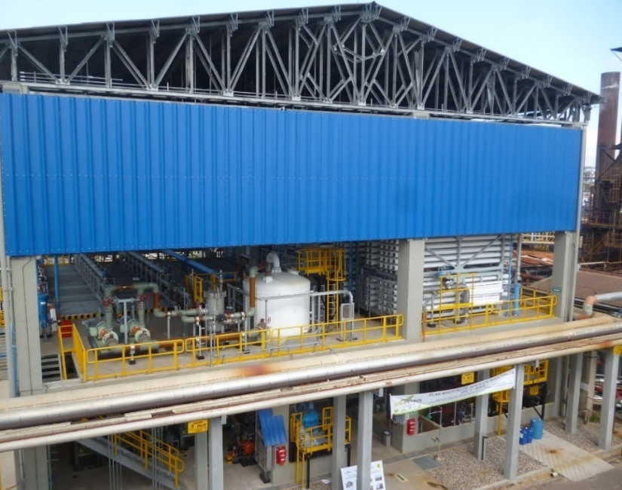
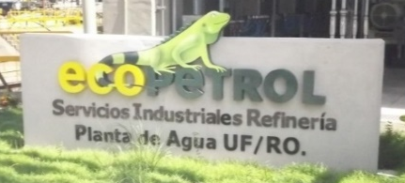
Ecopetrol Refinery - UF/RO Plant
Owner/Client: EcoPetrol S.A.
Location: Barrancabermeja, Columbia
Capacity: Ultrafiltration 10 MGD; RO 5.9 MGD
Start-up: 2013
Application: Oil refinery; water reuse; boiler feed
www.SafBonWater.com

Slide 4
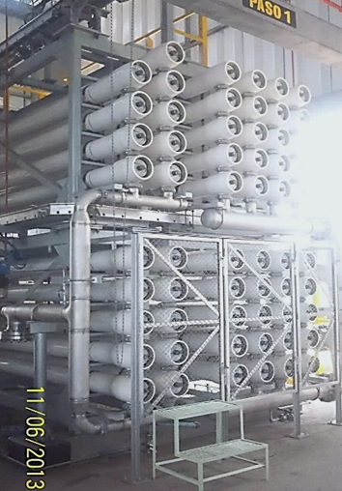
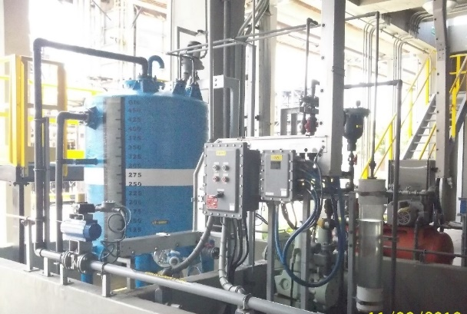
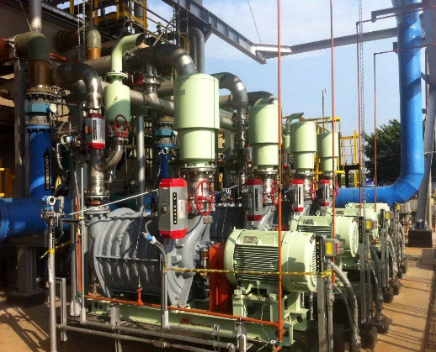
The advanced water treatment plant designed, fabricated and supplied by SWT produced low TDS water to feed the plant’s ion exchange system. The system consisted three submerged ultrafiltration trains capable of producing 10 MGD of filtrate. As well as three, double pass, brackish water RO trains capable of producing up to 5.9 MGD of permeate. The RO trains were designed to minimize the plant footprint; stacking the second stage on top of the first stage. Also high pressure feed pumps, transfer pumps, low fouling membranes, instrumentation and PLC control system. Field services included installation supervision, system testing, commissioning and start-up as well as training personnel.
Operational Data:
Feed water TDS: 237 ppm after UF
Permeate TDS: 0.15 ppm
Permeate flow: 1,374 gpm per train
RO Recovery: 77.5% / 87%

Slide 5
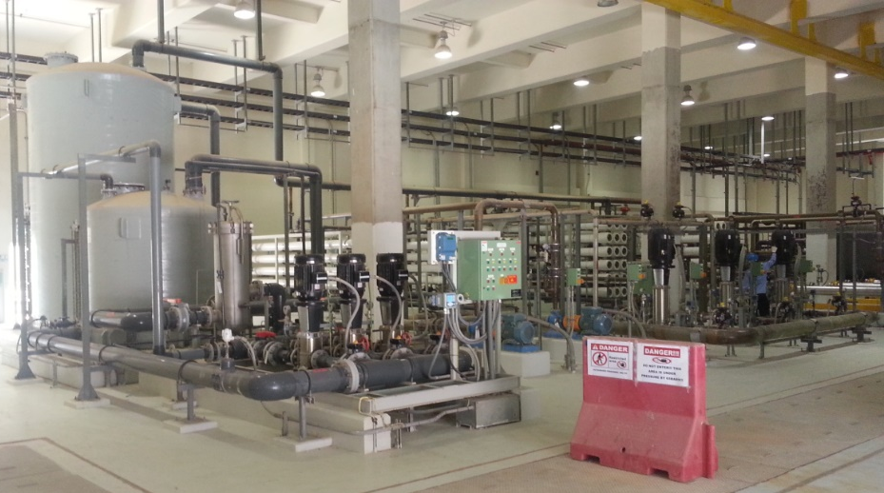
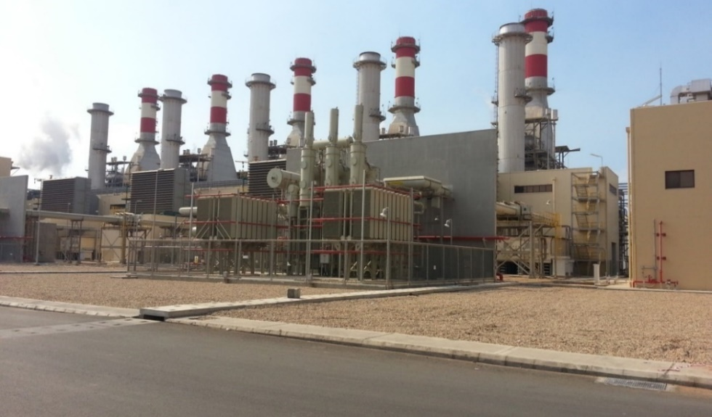
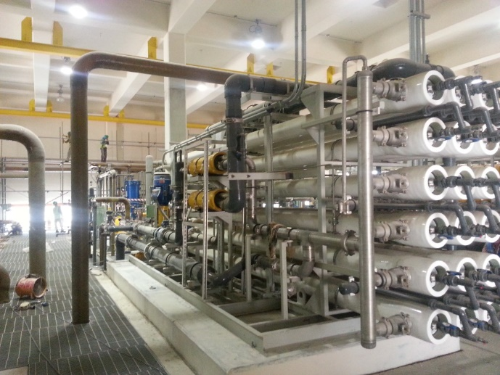
Shoaiba II Combined Cycle Power Plant (CCPP) – Desalination Plant
  Owner : Saudi Electricity Company (SEC)
Client: Daelim Industrial Co, Ltd.
Location: Saudi Arabia
Capacity: 2,400 m3/d
Start-up: 2015
Application: Power; SWRO; boiler feed
www.SafBonWater.com

Slide 6
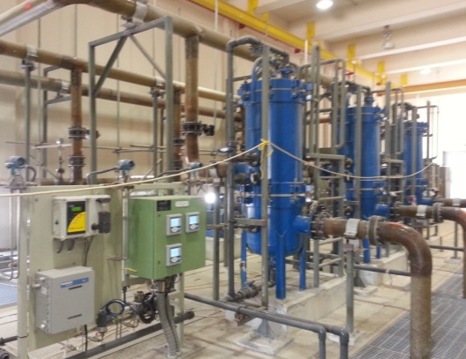
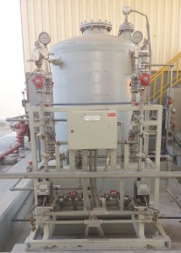
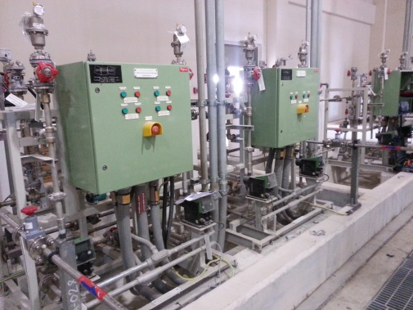
SWT was contracted to design, manufacture, and supply a seawater desalination plant consisting of dual media filters, double pass RO units, CIP and chemical dosing systems as well as all controls. We provided installation supervision, start-up, testing and commissioning services as well as operator training.
Operational Data:
  Feed water TDS: 42,640 mg/l
  Permeate TDS: 2.65 mg/l
  Permeate flow: 50 m3/hr
  RO Recovery: 40%
  Array: 15, 4:2 (Pass 1, pass 2: stage 2)

Slide 7
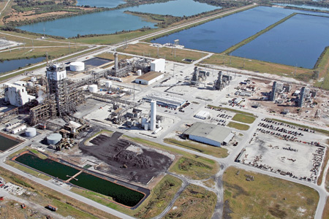
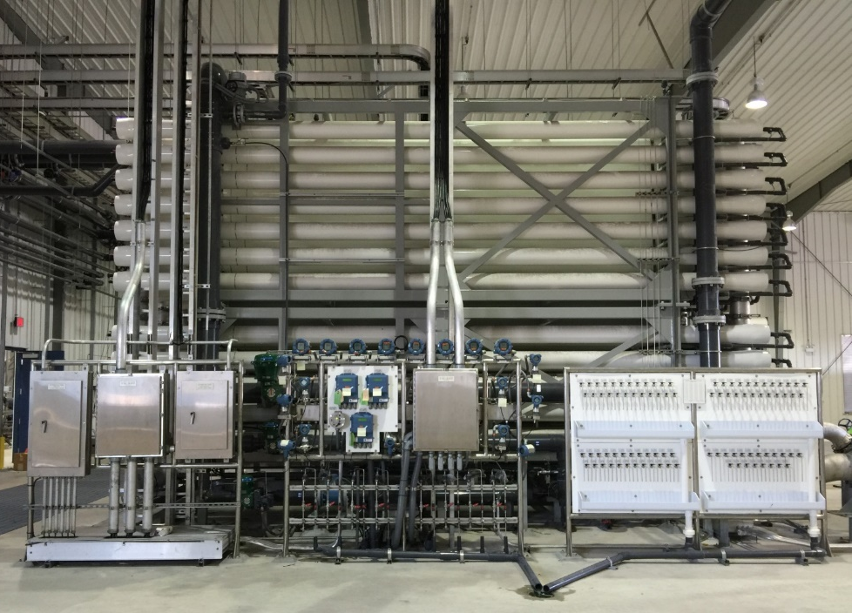

TECO Polk Power Station-Reclaimed Water Project
Owner/Client: Tampa Electric Company
Owner’s Engineer: AECOM
Location: Mulberry, FL, USA
Capacity: 7.2 MGD
Start-up: 2015/2016
Application: Industrial water reuse; power industry
Tampa Electric was awarded the 2015 Edison Electric Institute award for innovative projects utilizing reclaimed water.
www.SafBonWater.com

Slide 8
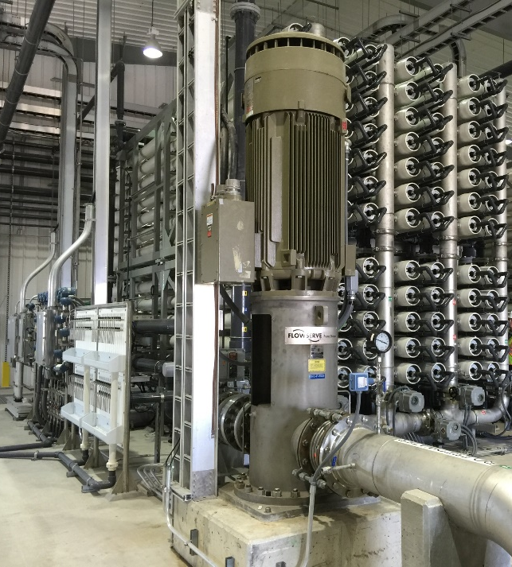
Operational Data:
This unique project demonstrates a public private utility partnership and reduces wastewater released into the environment. Treated wastewater from the local municipality is reclaimed and used as the feedwater to the RO system to produce high quality make-up water for the power station.
Feed water TDS:
Permeate TDS:
Permeate flow:
RO Recovery:
SWT provided the design, fabrication, delivery and installation supervision of three, brackish water RO trains. All chemical feed systems, local controls, CIP system, and instrumentation was supplied. The trains were completely shop assembled in two pieces to be bolted together for a complete unit allowing for very minimal site work. We have provided testing, start-up and owner training. SWT continues to work with the owners to assist them on improving pretreatment and pilot ultrafiltration.

Slide 9
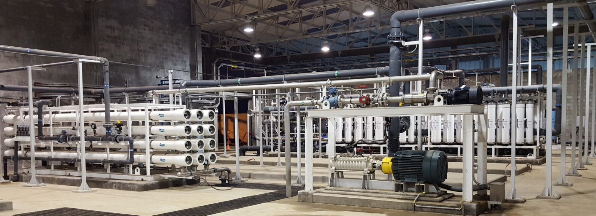
Cerro Lindo Mine-Seawater RO Plant
Owner / Client: Compañía Minera Milpo S.A.A. (member of Votorantim Metais Holding)
Location: Jahuay Beach, Peru
Capacity: 60 l/s in total plant - 3 x 12 l/s (Orig.); 1 x 12 l/s (Exp.I); 1 x 12 l/s (Exp.II)
Start-up: 2008 | 2013 (Exp.I) | 2016 (Exp.II) Application: Mining; industrial water treatment
The long relationship with this client has resulted in SWT being selected as the supplier for all three phases of construction for their seawater RO process.
www.SafBonWater.com

Slide 10
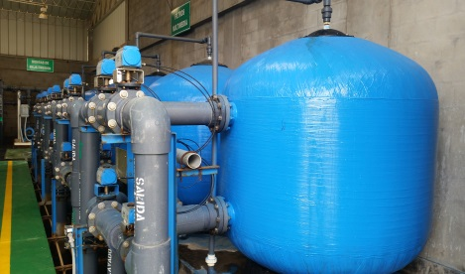
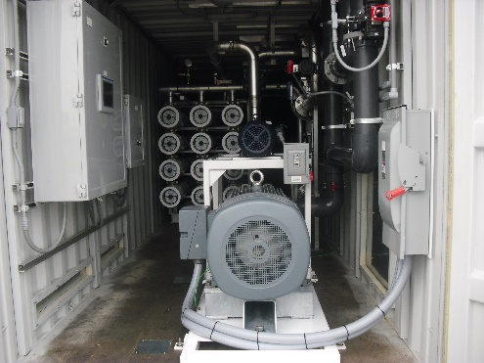
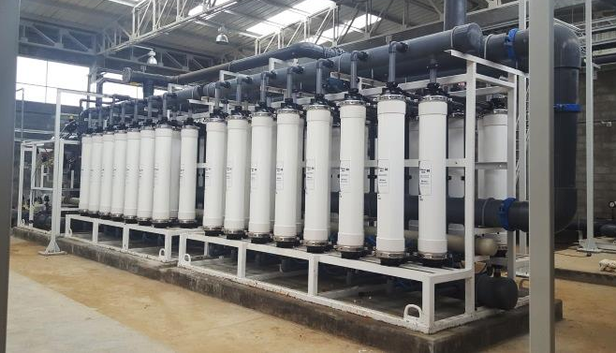
SWT performed detailed engineering, manufactured, and supplied the desalination plant. The final plant expansion will have five SWRO trains rated to produce 1036.8 m3/d (12 l/s) each, a total of 5184.0 m3/d (60 l/s) at 40% recovery. The turnkey, design-build contract also included testing, commissioning, start-up and owner training.
The permeate water will be used for mining operations and as potable water on site.
Original Plant
Expansion I
  Turnkey, design-build contract
  Multi-media filters
  Three SWRO trains (A,B.C)
  Remineralization system
  Instrumentation & controls
  Site work, building, intake/outfall, utilities, & yard piping
  One containerized SWRO system (Train D)
  Accessories
Expansion II
  One SWRO (Train E)
  One UF system, sized to feed two SWRO trains
  ERD & pumps,
  Instr. & controls
  CIP/flushing and chemical systems

Slide 11
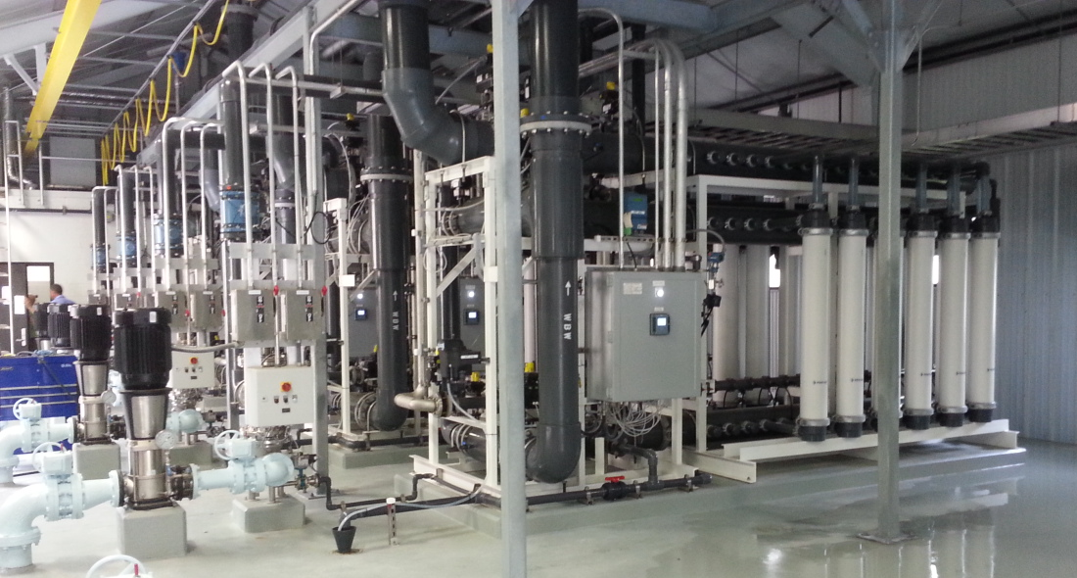
Palm Coast Water Treatment Plant No.2 – Concentrate ZLD System
Owner: City of Palm Coast
Client: Wharton-Smith, Inc.
Location: Florida, USA
Capacity: 1.8MGD
Start-up: 2015
Application: Zero liquid discharge, municipal NF concentrate
FEED
NF Concentrate
“This project is the result of years of collaborations with the local authorities. The brackish nature of the city’s ground water led them looking for solutions and this ZLD system design proved to be the most energy efficient high water recover option.”
M
Clarified water tank
UF
(Horizontal type, 20 units)
W/W feed Pump
Lime Clarifier
Dehydrator
Distribution
System
Sludge Thickener
Disposal
UF Treated Water tank
Sludge Feed Pump
www.SafBonWater.com

Slide 12
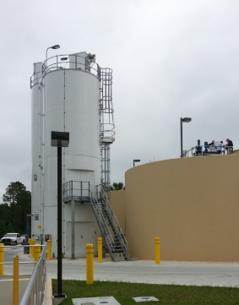
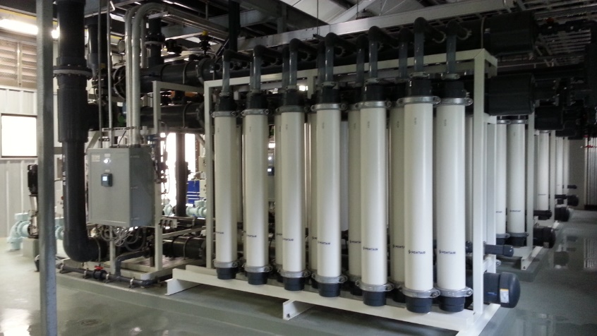
The City of Palm Coast was faced with the challenge of eliminating their liquid concentrate from their existing nanofiltration plant. Our engineers began working on this project from the conceptual stage with piloting and assisting the owner’s design consultant with full scale plant design. SafBon provided design, fabrication, supply and delivery of the system to treat and recover the NF concentrate through clarification, ultrafiltration and then treatment of the sludge. The filtrate from the UF system is fed back to the front of their NF process for treatment and distribution.
Operational Data:
Water Source: RO concentrate
Influent Quality : TDS: 610 mg/L (Ca 144mg/L, Mg 2.53mg/L)
UF Recovery : 92%
Flux: 35 GFD
SWT supplied lime clarifiers with chemical feed, lime and soda ash silos, UF trains with hollow fiber membranes, valves and local instruments. Installation supervision, testing, start-up, commissioning, and owner training were provided. SWT also assisted with operational issues to reduce TOC through enhanced coagulation during the testing phase.

Slide 13
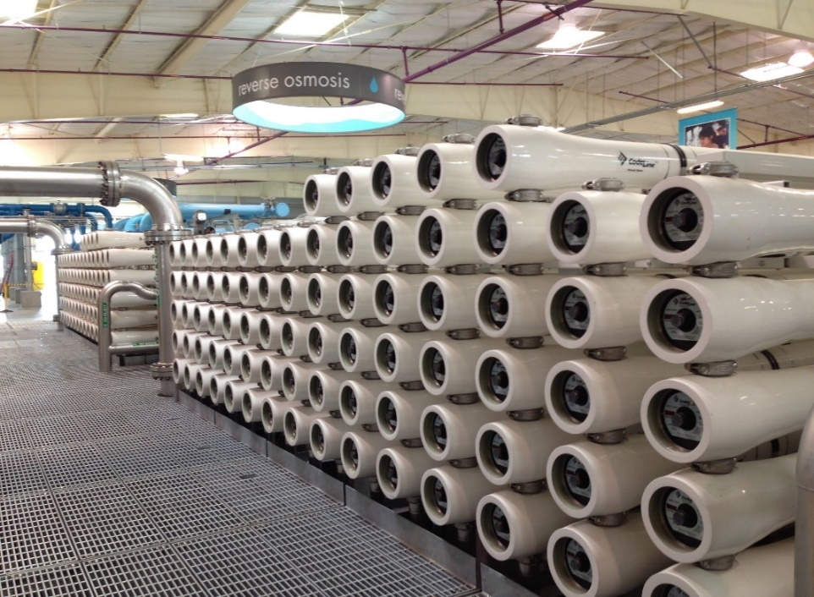
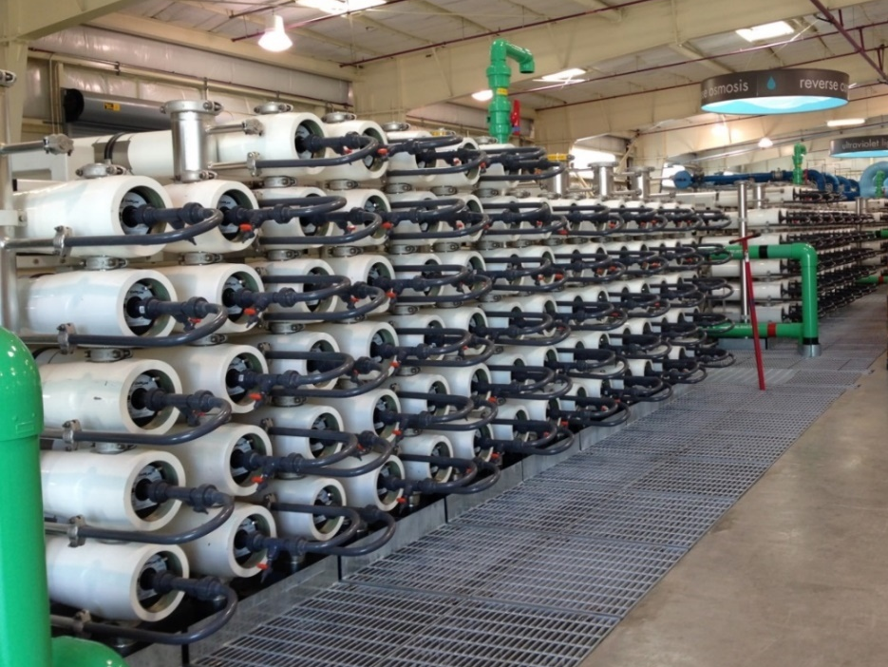
Silicon Valley AWTP or SCVWD – South Bay Advanced Recycled Water Treatment Facility
Owner: Santa Clara Valley Water District Owner‘s Engineer: Black and Veatch Client: J.R. Filanc Construction Company Location: Southbay, CA - USA
Capacity: 8.0 MGD Startup: 2014
Application: Municipal water reuse
    2015 Global Water Intelligence Water Reuse Project of the Year
www.SafBonWater.com

Slide 14
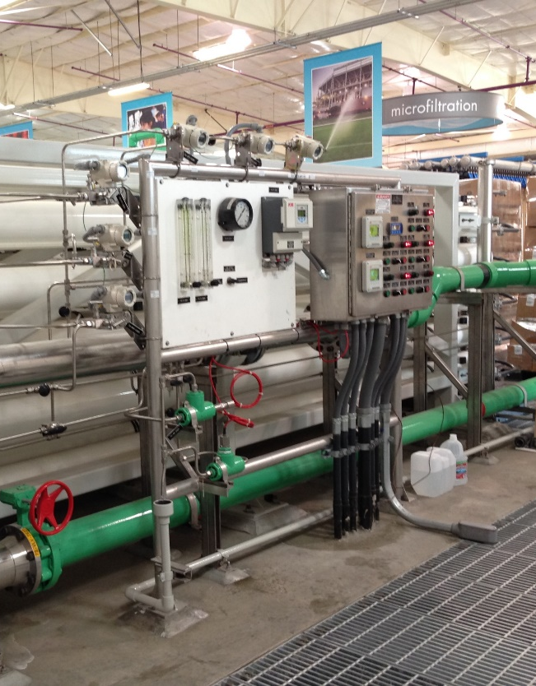
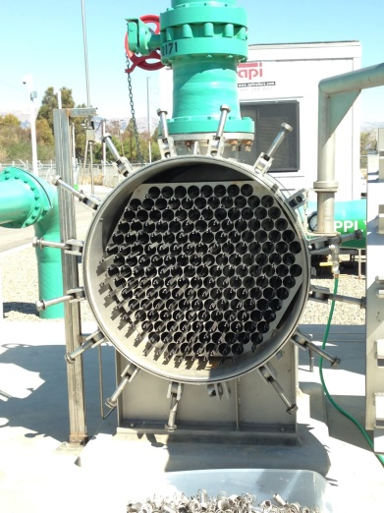
SWT was contracted by the owner’s general contractor to provide the design, fabrication and supply of the three brackish water reverse osmosis trains to treat tertiary treated wastewater. Also supplied were the cartridge filters, all local controls, instrument panels and sample panels. SWT provided installation supervision, testing, start –up and commissioning as well as training of the owner’s operators.
Operational Data:
Feed water TDS:
Permeate TDS: ppm
Permeate flow: gpm per train
RO Recovery:

Slide 15
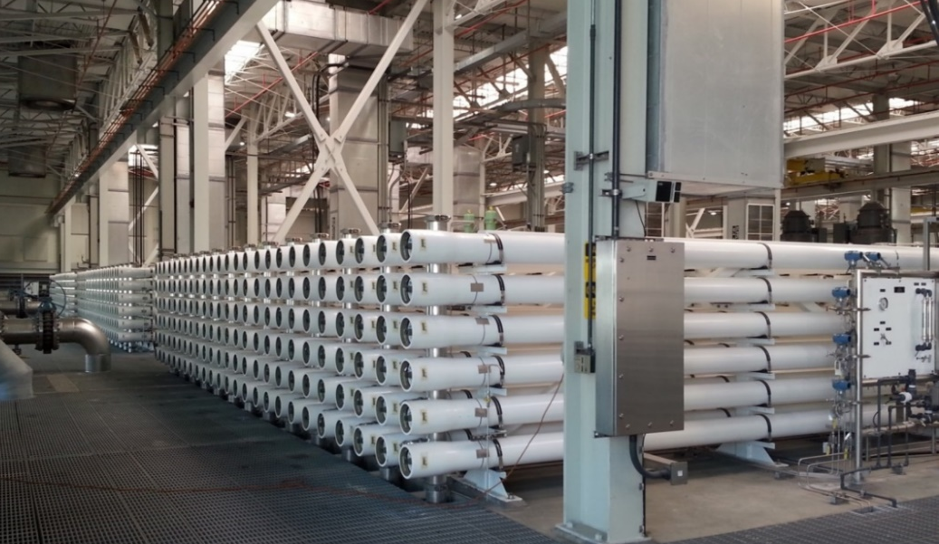
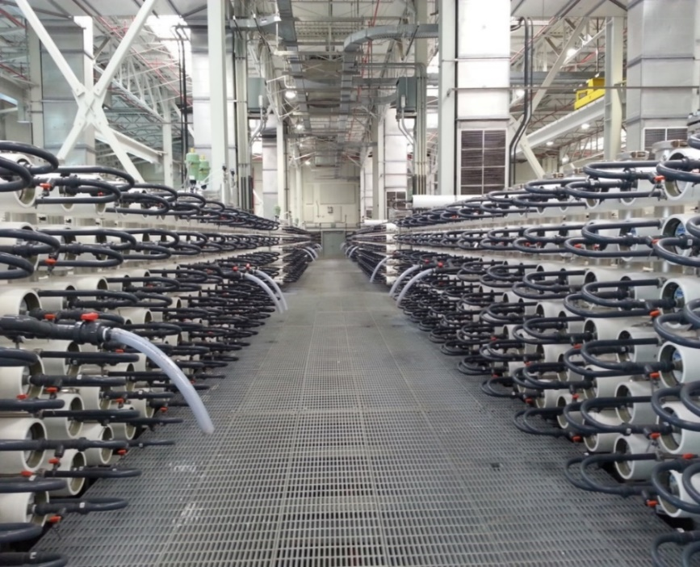
Advanced Water Purification Facility -Initial Expansion of the Groundwater Replenishment System (GWRS) Project
Owner: Orange County Water District
Owner’s Engineer: Black & Veatch
Client: McCarthy Building Companies, Inc.
Location: Fountain Valley, CA -USA
Capacity: 30.0 MGD (6 x 5 MGD)
Start-up: 2015
Application: Municipal water reuse, indirect potable
“The Orange County Ground Water Replenishment System is the largest water purification project of it’s kind in the world”. The overall plant produces 100 MGD of high quality, purified water.
www.SafBonWater.com

Slide 16
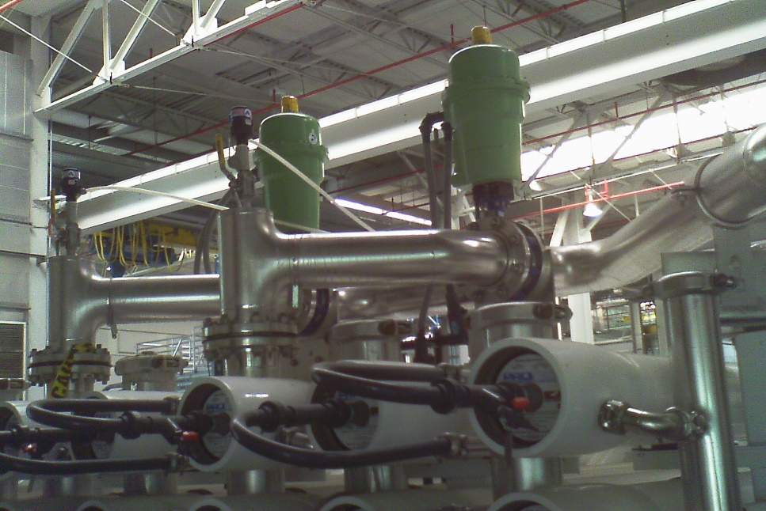
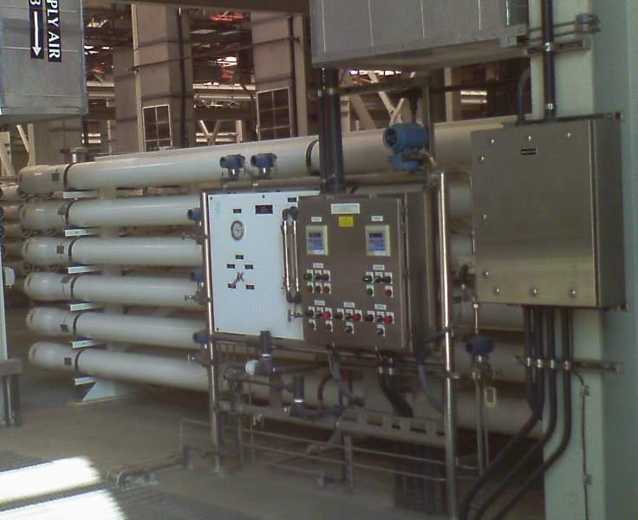
SWT was contracted by the owner’s general contractor to design, fabricate, deliver and supervise installation of the 30 MGD reverse osmosis system required for this project. The six RO trains are fed MF product water and RO permeate is further treated with UV and hydrogen peroxide to produce water that meets drinking water standards.
The RO system incorporated six FEDCO energy recovery turbines with VFD’s and PLC. The FEDCO ERD will recover ____ of energy reducing the size of the feed pumps by ___. SWT supplied all RO train local controls, valves, panels and Dow XFRLE-400/340i membrane elements. We provided system testing, start-up and owner training.
Feed water TDS: 936 ppm
Permeate TDS: 33 ppm
Permeate flow: gpm per train
RO Recovery:
Operational Data:

Slide 17
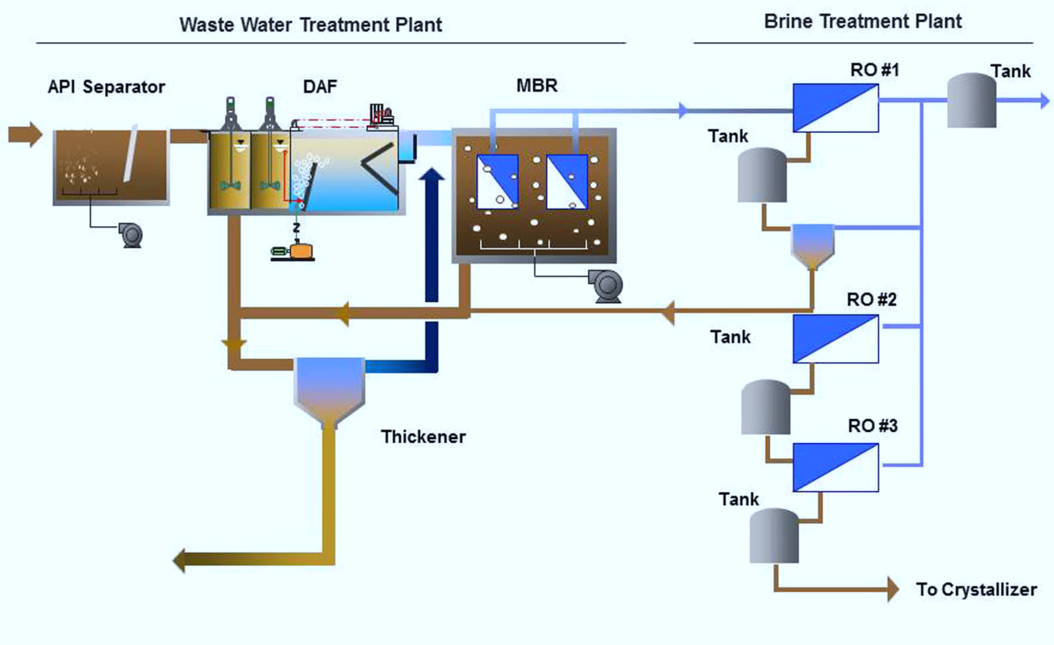
Karbala Refinery Project - Waste Water Treatment Package
Owner: State Company for Oil Project (SCOP)
Client: HDGSK JV (Hyundai E&C, Hyundai Eng., GS E&C , SK E&C)
Location: Karbala, Iraq
Feed Capacity: 12,672 m3/d
Start-up: Projected 2018
UF skd
“The Karbala Refinery Project, which includes the construction of four refineries, is expected to produce a range of products including liquefied gas, petrol, gas oil, fuel oil and jet fuel to serve growing domestic needs.”
www.SafBonWater.com

Slide 18
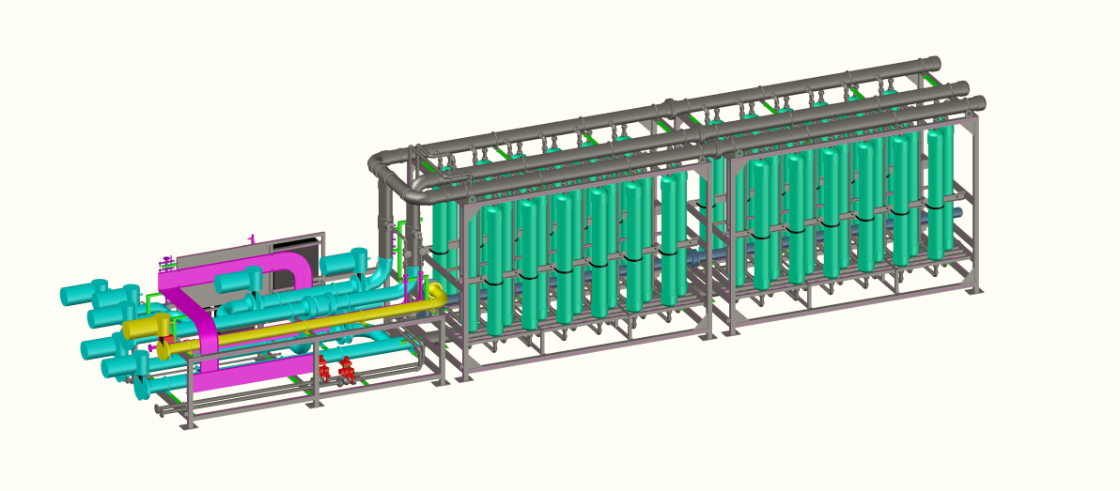
  SWT was awarded the contract to engineer and supply a complete turn-key, industrial wastewater treatment system for the Karbala Oil Refinery plant. This massive project consisted of API oil/water separator, dissolved air flotation, membrane bioreactor (MBR), activated carbon filters, ultrafiltration, softener, reverse osmosis, sludge thickeners and dehydrators.
  The product water will be re-used in the refinery plant while solid waste and RO brine will be sent to an incinerator and brine concentrator, respectively (provided by others), completing the Zero Liquid Discharge System.
Operational Data:
  1st RO product: TDS < 100 mg/L
  2nd RO product: TDS < 150 mg/L
  3rd RO product: TDS < 300 mg/L

Slide 19
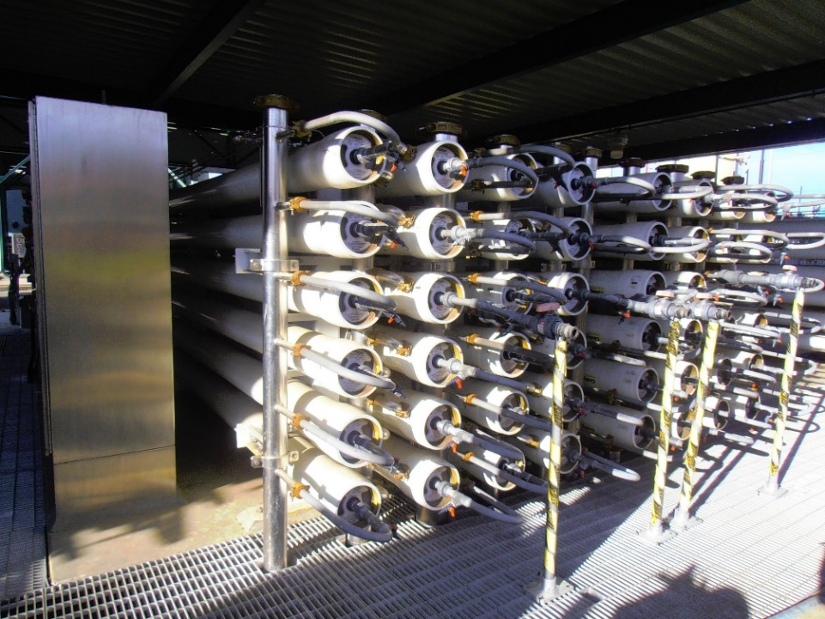
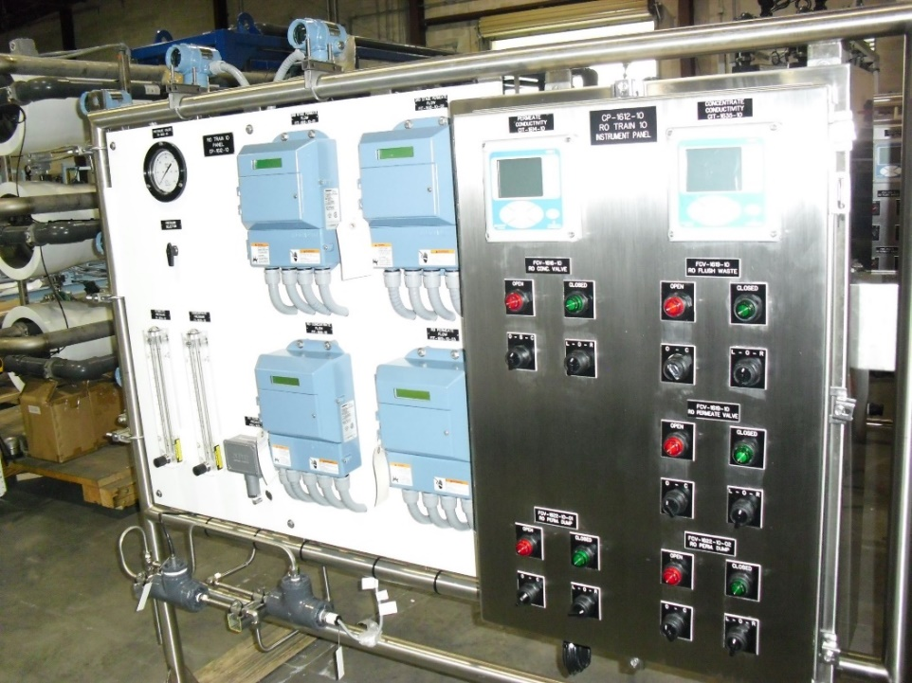
Edward C. Little Water Recycling Facility Ph.V Expansion (West Basin)
Owner: West Basin Municipal Water District
Client: Parsons RCI
Location: El Segundo, CA, USA
Capacity: 5 MGD expansion
Startup: 2013
Application: Municipal, water reuse
www.SafBonWater.com

Slide 20
USAID West Bank/Gaza IWP II-Middle Area Desalinization Plant Expansion
www.SafBonWater.com

Slide 21
Kawasaki

Slide 22
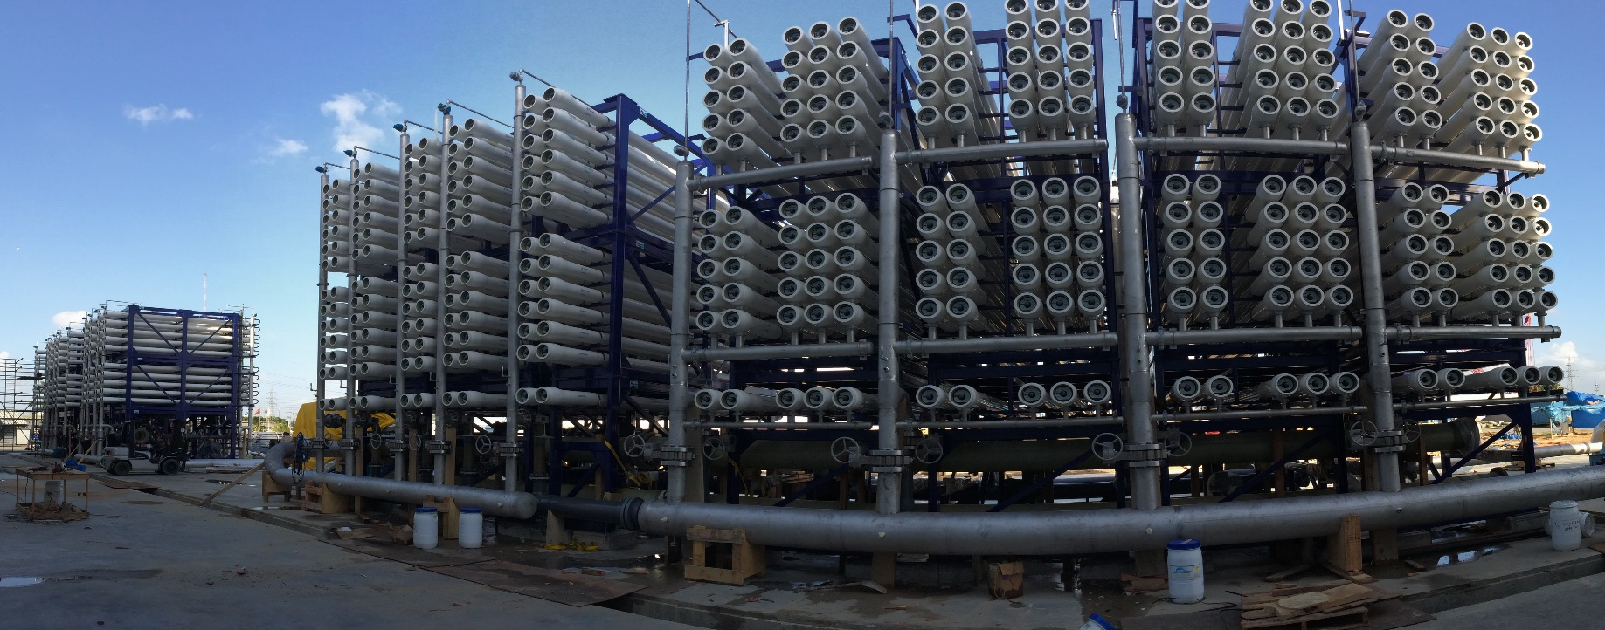

Desalination Company of Trinidad and Tobago (Desalcott)- Expansion
Owner: Desalcott
Client: Hafeez Karamath Engineering Services, Ltd.
Location: Point Lisas, Trinidad, W.I.
Capacity:
Startup: 2014
Application: Municipal desalination; plant expansion
www.SafBonWater.com

Slide 23
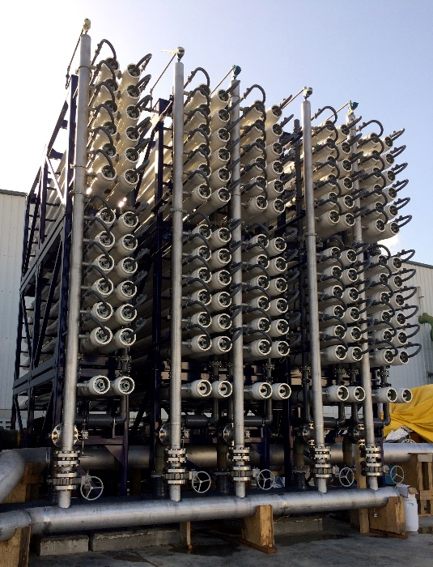
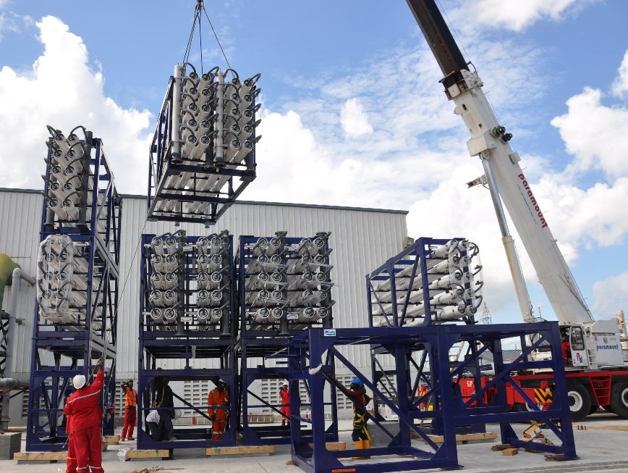
SWT was selected as the supplier for this massive expansion and fabricated all the trains in our US based manufacturing facility. The contract included the engineering, fabrication and delivery of the first pass seawater RO train G and the second pass brackish water RO for trains G and H. SWT provided systems that would integrate into the owner’s existing plant and utilize the existing CIP system. For the SWRO system SWT supplied twenty-one (21) full frames complete with multiport pressure vessels and piping. The BWRO equipment supplied consisted of eighteen (18) prefabricated frames with pressure vessels and piping. Scope of supply also included all train mounted valves and instruments as well as field services for installation supervision and commissioning.
Operational Data:
Feed water TDS: 35,000 to SWRO; 461 to BWRO
Permeate TDS:
Permeate flow: SWR0 7.78MGD; BWRO 6 MGD
RO Recovery: 60% SWRO; 94.5% BWRO

Slide 24
UMM Al Houl IWPP - Water & Wastewater Treatment System
Owner: Umm Al Houl Power Company, Qatar
Client: Samsun C&T Corp.
Location: Umm al Houl Economic Zone -Dora, Qatar
Capacity: 1.58 MGD
Startup: 2017-2018
Application: Power production; wastewater treatment; demineralization
“Umm Al Houl Power is an independent Water and Power producer, established in midyear of 2015. Capable of generating 2,520 megawatt of power and 136.5 million gallon drinking water per day.”

Slide 26
Scope:
Engineering, manufacture, and supply of one complete Water and Wastewater treatment plant consists of:
2-pass RO system
EDI Demin system
Pumps
Cartridge filters
CIP skid
Chemical dosing Skid
Sewage treatment package
Oil-water treatment unit
Process waste water treatment unit
Interconnecting piping, valve, instruments and controls.
  Provide field services for:
    Installation Supervision,
Testing, Start-up and commissioning services, and
Training
Operational Data:
  Recovery:
    1st Pass RO ≥ 85%
    2nd Pass RO ≥90%
    EDI Unit: ≥90 %
  Demi. Conductivity : <0.08㎲/cm at 25℃
  WWTS: Qatar treated wastewater discharge limits
Capacity: 1.58 MGD (3 x 83 m3/h [ Max. EDI Demin train]
Two pass RO system
EDI demin system

